Slide 1
Building a (solid) portfolio
Diversification & risk

Slide 2
Risk (8 min)
Diversification (7min)
Activity (8min)
Money Funds (6min)
Kahoot (12min)
Extra (5min)
Outline

Slide 3
What is risk?

Slide 4
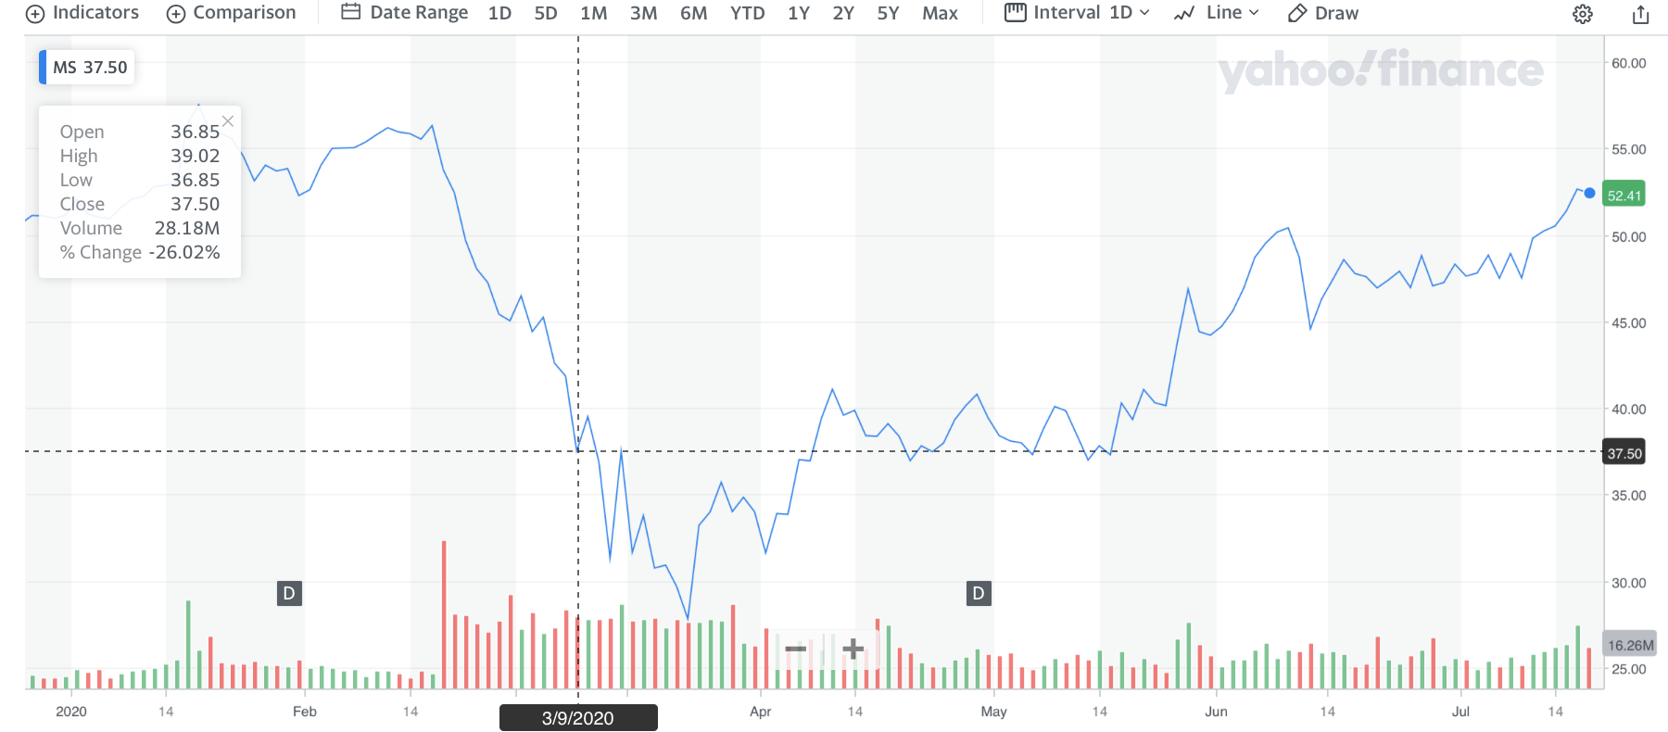
Risk
In investing, the probability that a stock price will not be what you expect.
I.e Morgan Stanley at $52

Slide 5
Cryptocurrency
digital money
unregulated by gov
VOCAB: decentralized; democratic
online transactions (anon)
Notes:
What is it? - digital money unregulated by gov
What is it used for?

Slide 6
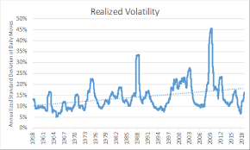
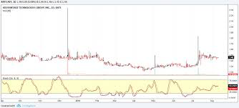
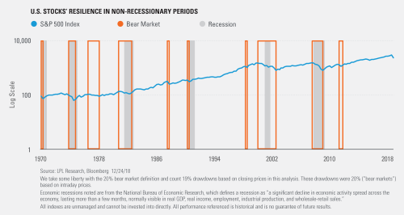
Volatility
How do you describe how risky an investment is? -> volatility
Volatility is a “unit” for risk, like dollars, lbs, etc
The more risk; the more volatility
Which is more volatile? (left or right)
Notes:
The more volatile - the more fluctuating the graph is.
Which is more volatile, the left or the right?
ANSWER BELOW VVVVVVVVVVVVV
Assuming the pictures are to scale, the left side is more volatile b/c its “ups” and “downs” are much larger the picture on the right part.

Slide 7
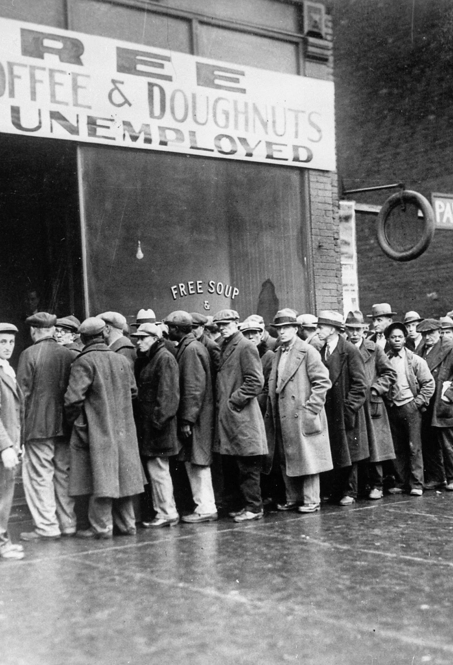
What types of risk are there?
Systematic - risk that affects all companies indiscriminately
I.e The Great Depression; inflation might cause this
Unsystematic - risk that affects a specific company or industry
Pandemic affected travel (Industrials), but not all Tech companies (zoom)
Notes:
Inflation - ppl take their money out of the market and save it

Slide 8
China and the U.S. ignite another trade war; all of sudden cpu parts prices increase dramatically? Would this be systematic or not?
A natural disaster occurs? Is this systematic or no?

Slide 9
Deal with unsystematic risk
Not much you can do if global issues
Have to save until things become better
Not the focus of this class…...

Slide 10
How to deal with (unsystematic) risk?
Notes:
Market orders
If you place a stop loss, you can minize risk

Slide 11
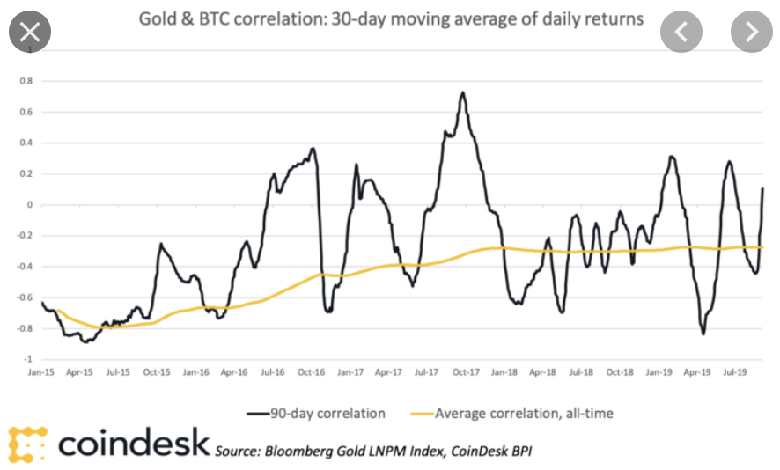
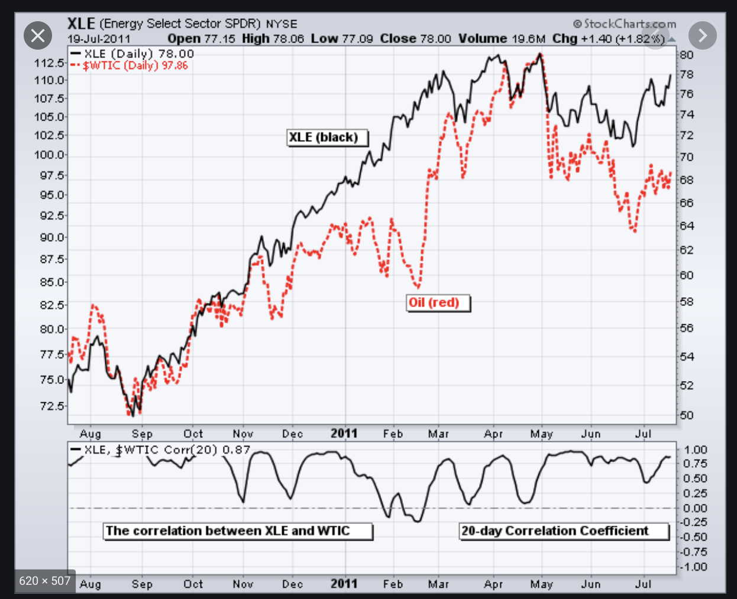
Goal: Uncorrelated - trends that don’t move same way
Gold and bitcoin
So, maybe its clear which is uncorrelated?
Notes:
Which graph has a higher correlation?
- The left
Why would a stock be (un)/correlated?
- Stocks that are similar tend to have high correlation. The opposite is also true.
Stocks that belong in the same industry (apple and google), would correlate, while stocks in different
Industries (apple and JNJ) wouldn’t, for instance

Slide 12
What are Correlations? - How closely the prices of two stocks move together or not
Can be positive or negative
Notes:
Positive correlated

Slide 13
What is diversification?

Slide 14
Diversification
Investing in stocks with different features, like location, industry, etc.
Diversification allows you to “cushion” your losses
If one stock falls, at least the other might rise
Likewise with baskets of eggs
Not the best idea...

Slide 15
Diversification
I.e Apple and JNJ? If I invest in both, that be diversified?
Apple - laptops, phones, software
JNJ - health, beauty, home-stuff

Slide 16
Diversification
I.e Apple and JNJ? If I invest in both, that be diversified?
Both are large, different businesses, performance directly related
They are “different enough”

Slide 17
Diversification
Can apply to different assets
Stocks, bonds, gold
I.e. usually have stocks to balance with slower more stable bonds.

Slide 18
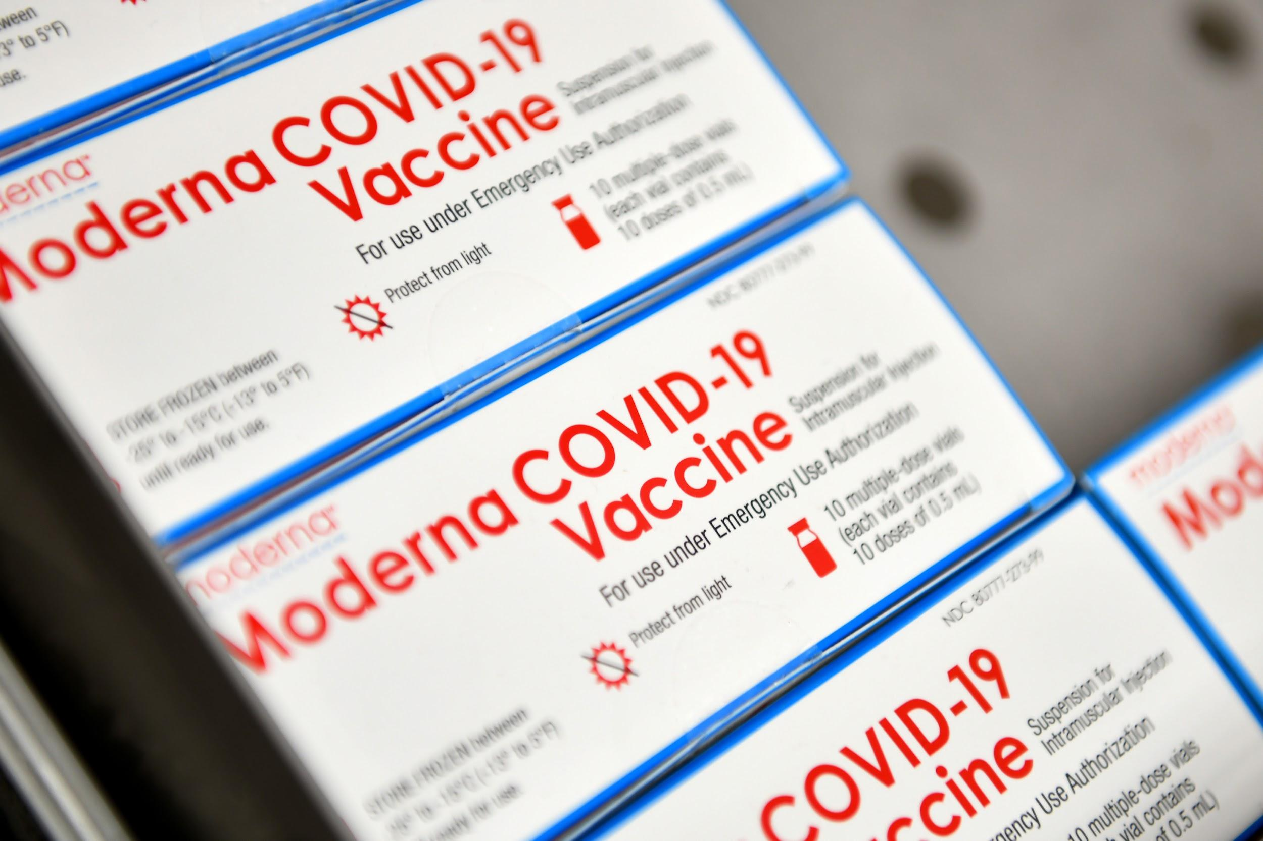
Is this diversified investment?
Notes:
Debateable; if something happened to moderna would this affect astrazeneca
Different drugs/different locations - ther’s different ways to diversify
We’ll cover them

Slide 19
How many ways can you diversify?

Slide 20
Diversification by Sector Definitions
Communication Services - tv, phone
Consumer Discretionary - your wants: gadgetry, entertainment
Consumer Staples - your needs: food, beverage, etc.
Energy - oil and gas companies (exxon mobil)
Financials - banks, insurance companies
Health Care - pharmaceutical companies (shockwav)
Industrials - companies that produce goods like aircraft, trains, buildings;
Information Technology - computer software, (adobe/amazon)
Materials - companies that produce raw materials: metal, plastic, cardboard, concrete
Real Estate - housing
Utilities - services used by the public: i.e. sewage, telephone, and transportation.
Notes:
Which industries would un/correlate?
Answer is below VVVVVVVVV
Examples
Correlated:
Financials/IT -> a lot of bank transactions can happen with the help of technology
Consumer Staples/health -> many products that are necessary pertain to health
UnCorrelated:
Real Estate
IT
Not much relation
Energy
Financials
Again, not much relation
based the cbs article found:
factors hit by pandemic
Travel
Lodging
Entertainment
Energy and oil and gas
Nonessential retail
Automotive
Sectors that “fared relatively well to date” include:
Health care and pharmaceuticals
Technology and telecommunications
Financial services
“Consumer products”
comm services: tv, phone

Slide 21
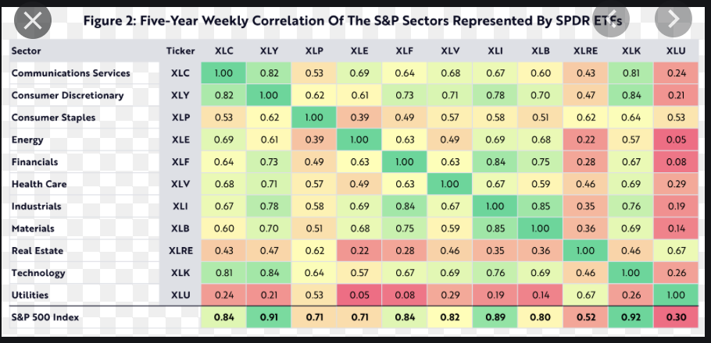
Notes:
Locate how correlated health care is with energy
Look up “sector correlation” -> find a chart like this

Slide 22
Other means of diversifying
By country - US, Japan, Latin America
By how many stocks you own per company
By some metric (i.e. subsector, size, profit)
Notes:
By country - useful if one country is, for instance, suffering from a trade war
By number - every company has its own unique features, so having more stocks -> more diversified
By assets - You can diversify by investing in different assets…
You can diversify by any means, but these are some of the more common ways

Slide 23
Diversification Activity

Slide 24
Compare 1st and 2nd column- which is more diversified
Notes:
A is more diverse interms of industry, and not so much symbol
B is moreso in quantity/symbol and somewhat diverse in industry
C is slightly diverse in symbol, not so much industry

Slide 25
ETF? MTF? HF? Role in Diversification

Slide 26
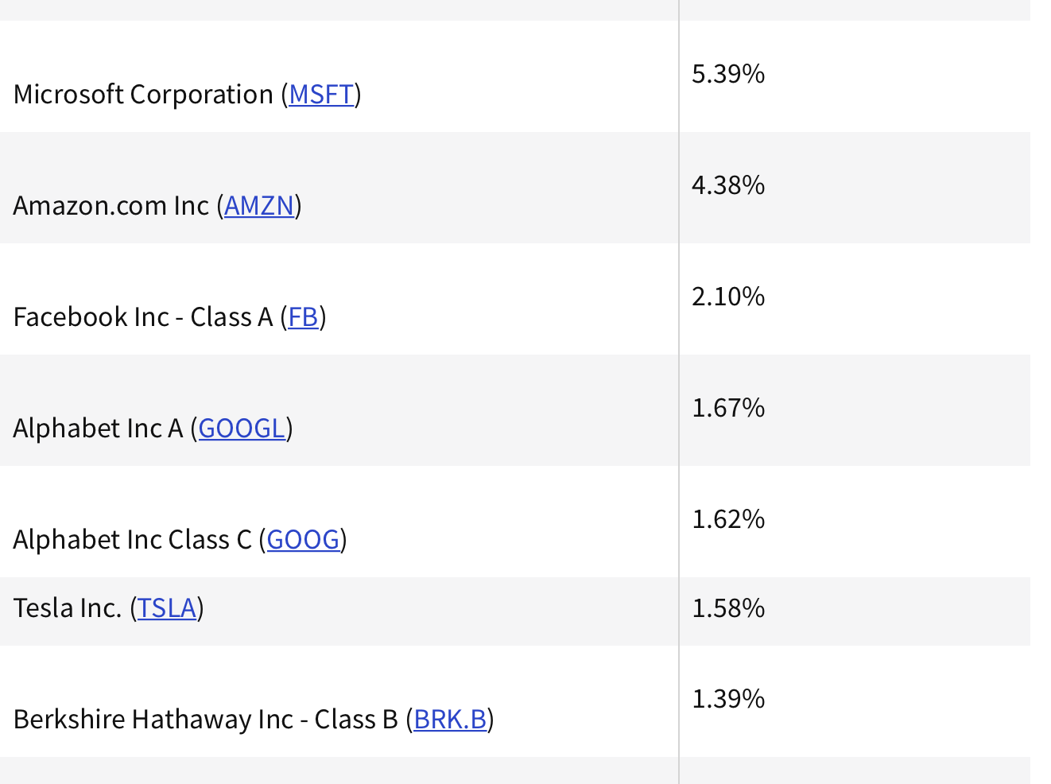
ETFs (exchange Traded Fund)
ETF (Exchange Traded Fund) “tracks” the performance of many companies
Is similar to buying many companies at once
Notes:
*Exchange-Traded -> why is it called that? Because, like any other stock, you can buy them in an stock exchange -> a place where you can buy stocks.
Can also have etfs for specific industries, like healthcare; or even specific categories, like “high-dividend”-paying companies
S&P ->

Slide 27
ETFs (exchange Traded Fund)
Great way to diversify
Example: S&P500
Notes:
*Exchange-Traded -> why is it called that? Because, like any other stock, you can buy them in an stock exchange -> a place where you can buy stocks.
Can also have etfs for specific industries, like healthcare; or even specific categories, like “high-dividend”-paying companies
S&P ->

Slide 28
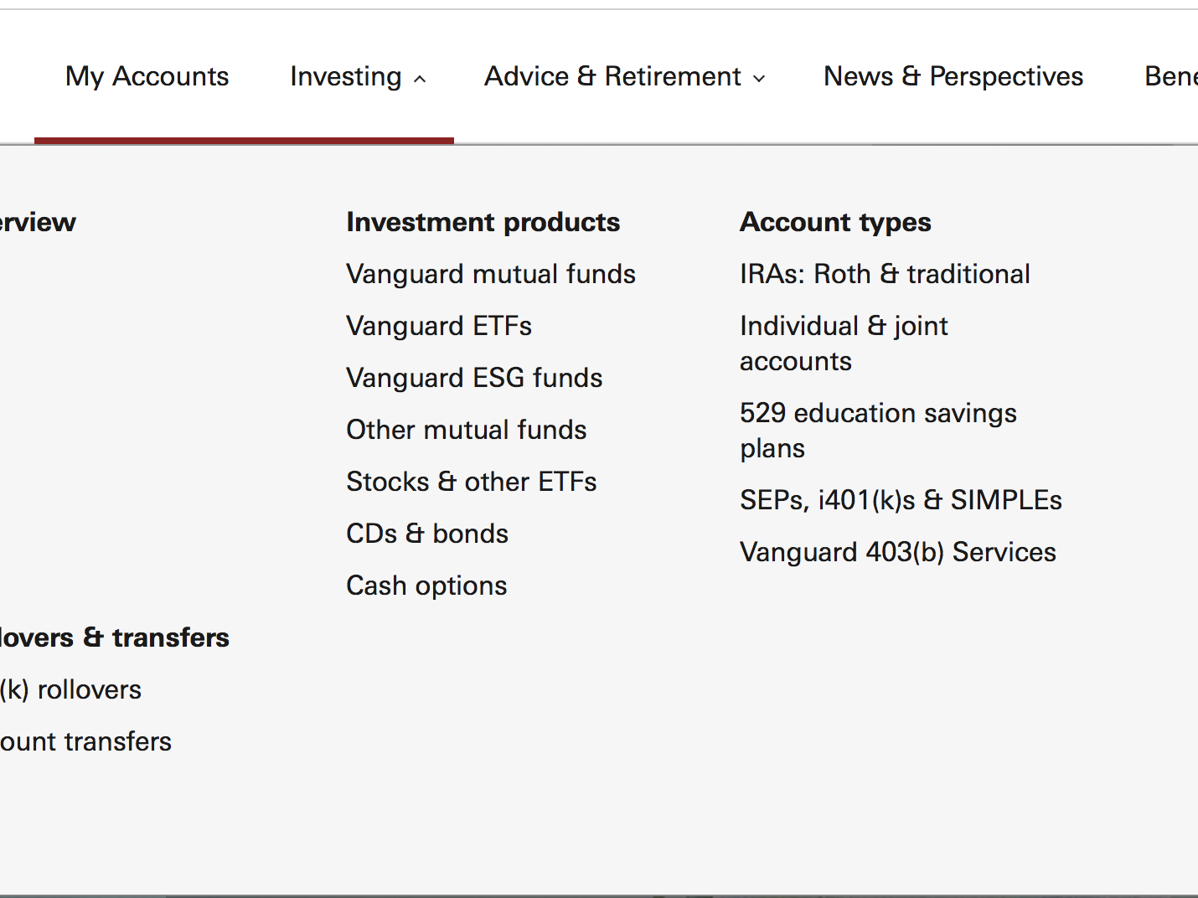
Ways to diversify (with help)
Mutual funds - a fund that is managed by a group of investors;
less risk via diversification,
Professional, not personal management
Notes:
Risk averse investors would buy _____
Risk loving investors would prefer ______

Slide 29
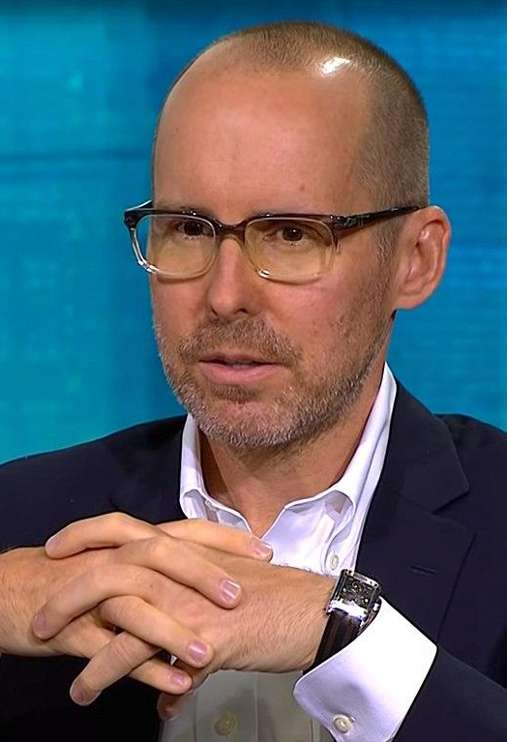
Hedge funds?
Key Differences from Mutual Fund:
More expensive than a mutual fund
Uses riskier strategies than a mutual funds
Thus, has potential for greater returns
Notes:
Taken directly from investopedia:
Hedge funds are private investments that are only available to accredited investors.
Hedge funds are known for using higher risk investing strategies with the goal of achieving higher returns for their investors.

Slide 30
The differences of each fund can be demonstrated using spectrums, which are:
Less risky -------------------------------- very risky
Cheap ------------------------------- expensive
Less profitable ------------------------------- Most (potential )profitable
For each range, ETFs would be on the left, Mutual funds in the middle, and Hedge funds, on the right

Slide 31
What is Cryptocurrency?

Slide 32
Cryptocurrency
Digital Currency (bitcoin, ethereum, etc.)
decentralized
non-regulated by govt
anonymous
Notes:
What is it? - digital money unregulated by gov
What is it used for?

Slide 33
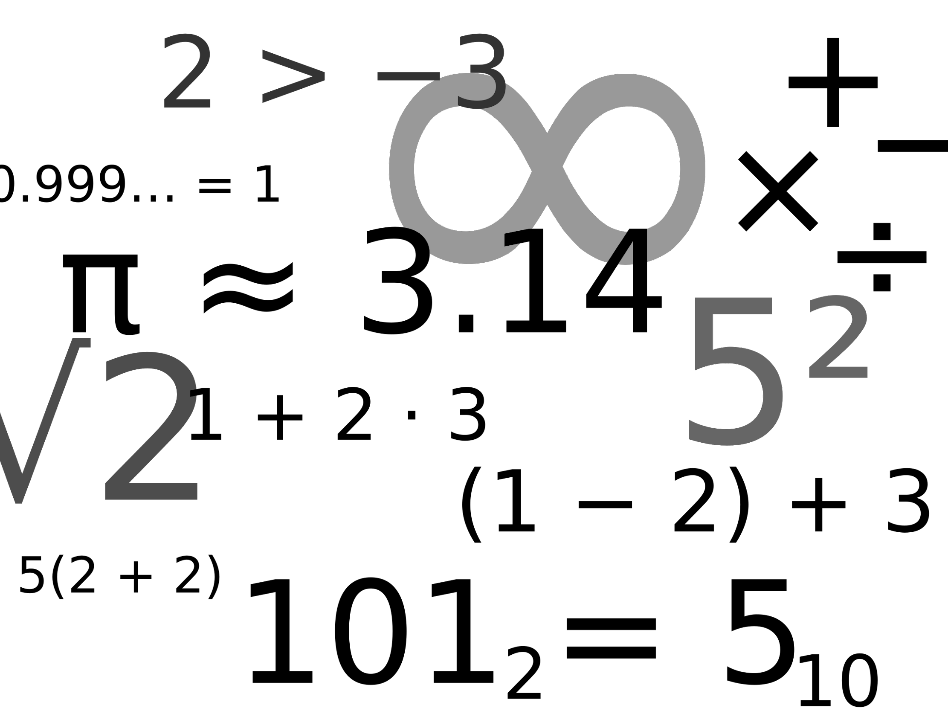
Cryptocurrency
2) Created through mining
solving math problems
3) transaction happens via Blockchain
Notes:
What is it? - digital money unregulated by gov
What is it used for?

Slide 34
Is it useful? - Cons
> Seen as a tool for gambling;
> No use in most online retailer;

Slide 35
Is it useful? - Pros
anonymous transactions
protection from bank failures

Slide 36
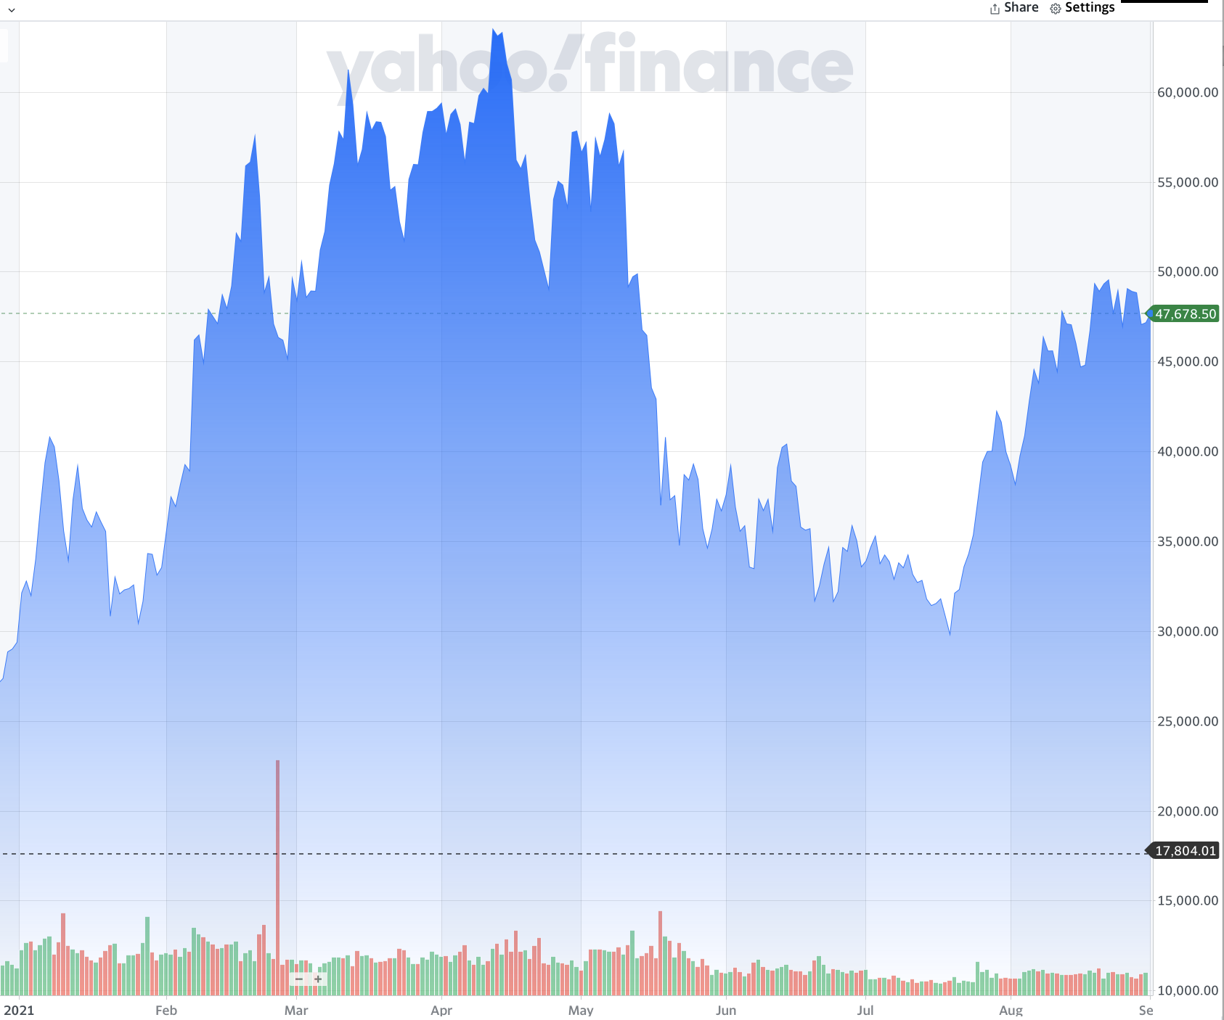
Should I invest?
~ Bitcoin shows volatility
~ large price range (17k-47k)
BE CAREFUL!!!!
Notes:
what was the price in 2021? in Sept?

Slide 37
On the other hand to consider
-> greater use of digital currency possibly
-> security issues?
-> not well appreciated by all

Slide 38
Miscellaneous Questions
What is a bond?
A loan; usually to the government or to a company
You get Interest

Slide 39
Miscellaneous Questions
I buy a corporate bond (from apple). The FACE VALUE is $1000
FACE VALUE: value of the bond when loaners pay me.
The coupon rate is 5%
Interest paid per year
5% of 1000 is…
Hold bond for 5 years, face value 1000, cr - 5%, assume interest rate is zero

Slide 40
Options
Trade stocks by betting
I.e say you buy an option stock, apple, which is normally 150, at say $10
Pay a premium (range from 0-140)
Buy AT a particular date (maybe Nov 1st)
IF Apple falls, yay! Else, you lose money

Slide 41
Options
Can be safer since you pay a premium
A little trickier to learn...

Slide 42
WHAT’S A REASON TO INVEST?
What is NOT a feature of cryptocurrency transactions
it’s decentralized
It’s regulated
It’s transparent
It’s volatile (rapid price swings)

Slide 43
Major Takeaways
Risk -> probability of stock price basically not being what you expected
Diversification -> choosing stocks with different features, like size, reduces risk
Easiest way to diversify -> buy ETFs or Invest in Mutual Funds
Most popular: the S&P 500

Slide 44
What we covered
Basics of Investing
How Stock Market works?
How to Invest?
Why Invest?
Technique to Analyzing Companies
Technical Investing
Fundamental Investing
tesla, gamestop, moderna
How to own a diversified collection of stocks
Risk
Diversify by sector, subsector
ETFs, Crypto, etc.

Slide 45
Please Fill out Survey
Ask Questions!
Thank you, and please follow up by
Visit market site like nasdaq/yahoo finance and start adding to watchlist
Go to investopedia sim; make an account
If you know for sure you want to invest: download trading app
Feel feel to: Review slides/ research on investopedia/taking econ courses, etc.

